Slide 1

Get serious . . . about automation.

Slide 2
Old Technology
This presentation is about a really old technology, Windows' batch files. Does anybody use Windows' batch files?
Many batch files I've seen in the wild are pretty messy. They are often quite long and not well structured. I know this partly because I've written hundreds of them. I wrote batch files for years that were a mess. I like to think I'm a little better now.
For Example, I googled "typical batch file" and this was the first hit:
https://www.instructables.com/id/5-Cool-Batch-Files/

Slide 3
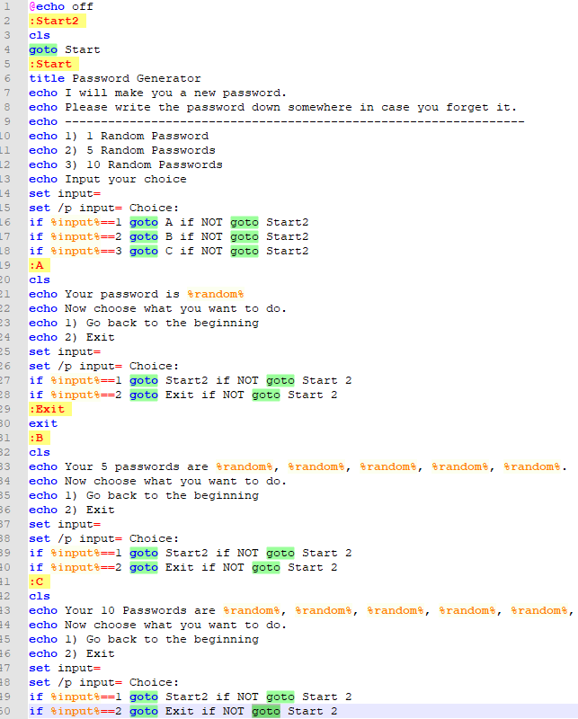

Slide 4
This small file has 19 goto statements! Makes my head hurt looking at it.
The lack of structure is a problem and leads to hard to read and understand code.

Slide 5
How to Modularize?
So let's impose some structure. In most programming languages there's a concept of a function.
At the heart of Composable Batch Files is the enforcing the use of traditional functions or code blocks.
Anatomy of a function. Here are the basic structural elements:
[label] = function name (which must be unique)
call :[label] = function call to another function in this batch file.
goto [label] = also a function call, which does not return to the caller. Use judiciously.
exit/b = end of function. The lack of exit/b is the most common culprit. Without ending
functions, you have spaghetti code.

Slide 6
A More Structured and Functionalized Approach
Building the batch file around the a set of functions can turn a normally disorganized environment into a structured and organized one.

Slide 7
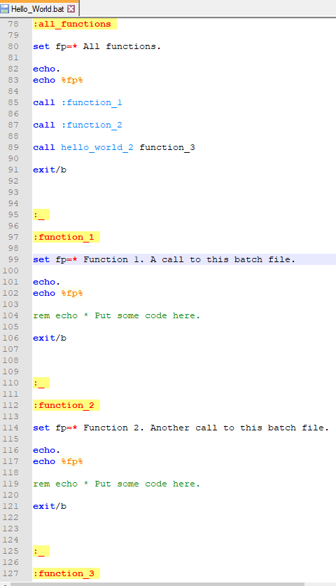

Slide 8
Scalable Self-Documenting Scripting
A cool thing about this architecture is that it is scalable in the sense that if you want some new script feature all you need to do is add a unique label and a code block and you are up and running.

Slide 9

To download and for more info., see:

